Slide 1
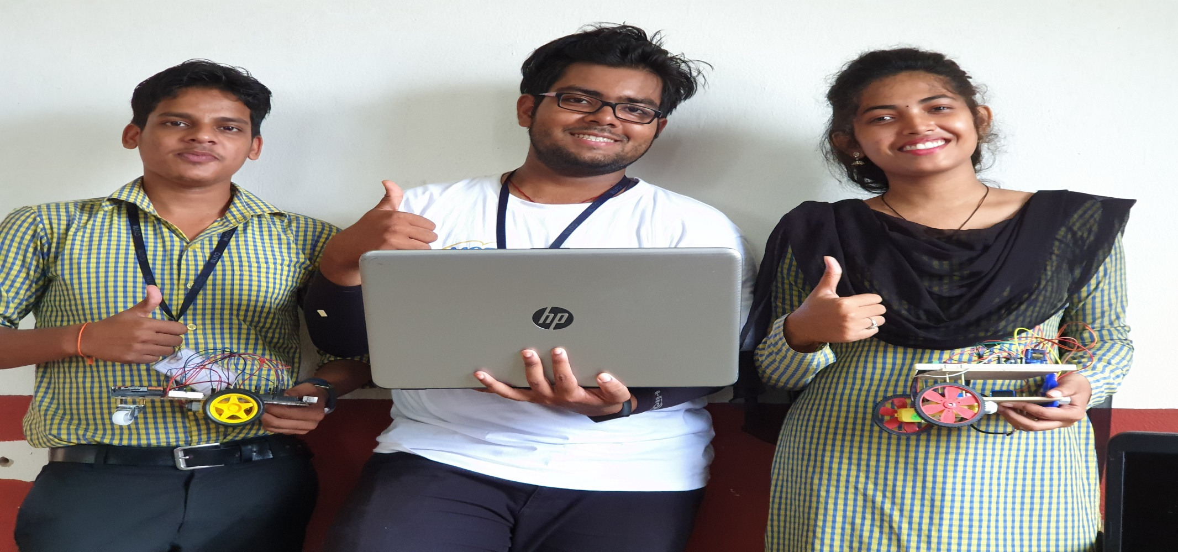

SIXTH SENSE ROBOT
Supervisor – Mamata Garanayak
Payal Bhadra – 160301120197
Sujit kumar Sahoo – 160301120194
Avijit Balabantaray - 160301120185

Slide 2
Presentation Outline
Introduction
Objective
Results and Discussion
Conclusion

Slide 3
OBJECTIVE
To create an obstacle avoidance autonomous robot , which can perform some movement operations by tracking the gestures from human hand as well as voice.

Slide 4
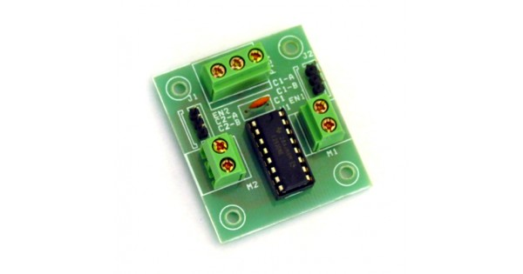
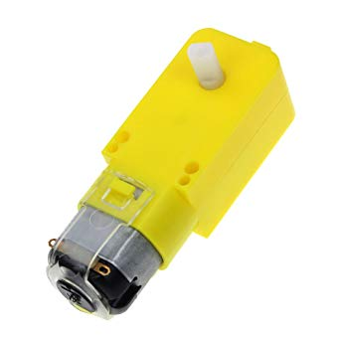
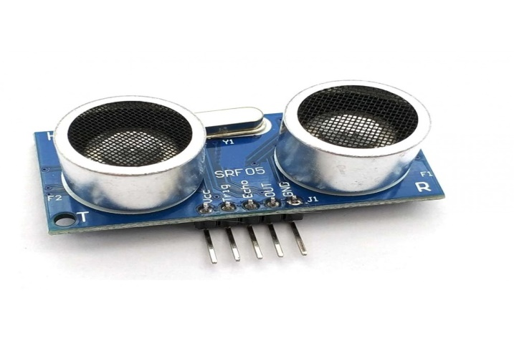

TECHNOLOGY & COMONENTS
1.Arduino UNO
2.Ultrasonic sensor
3.Blutooth Module
4.Servo motor
5.Motor Driver
6.BO Motor
7.Python
8.Computer Vision

Slide 5
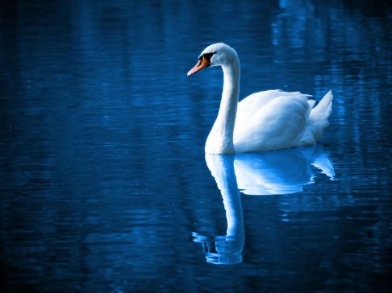
What is Computer Vision ??
Computer Vision is the method of using machines to recognize and investigate images (both pictures and videos).
Image Processing
Set of Pixels
Set of Pixels
Computer Vision
World Model

Slide 6
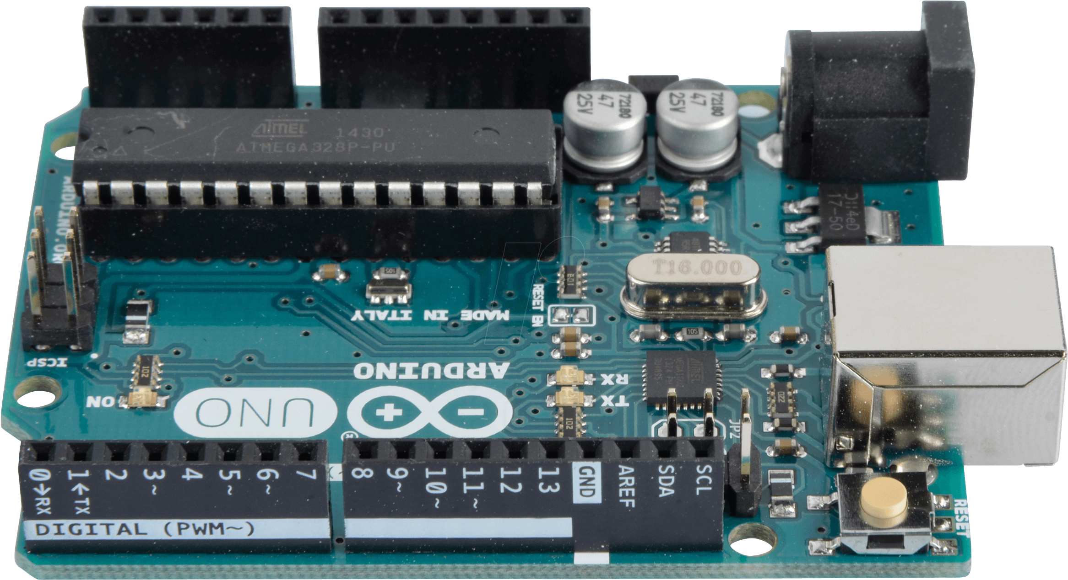
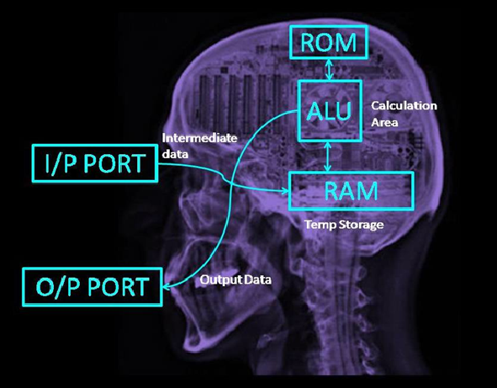
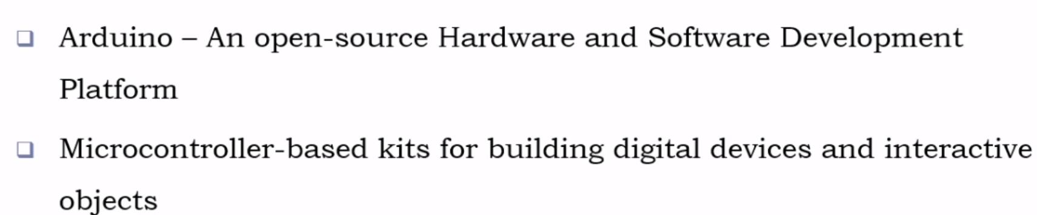
Arduino-Uno Microcontroller

Slide 7
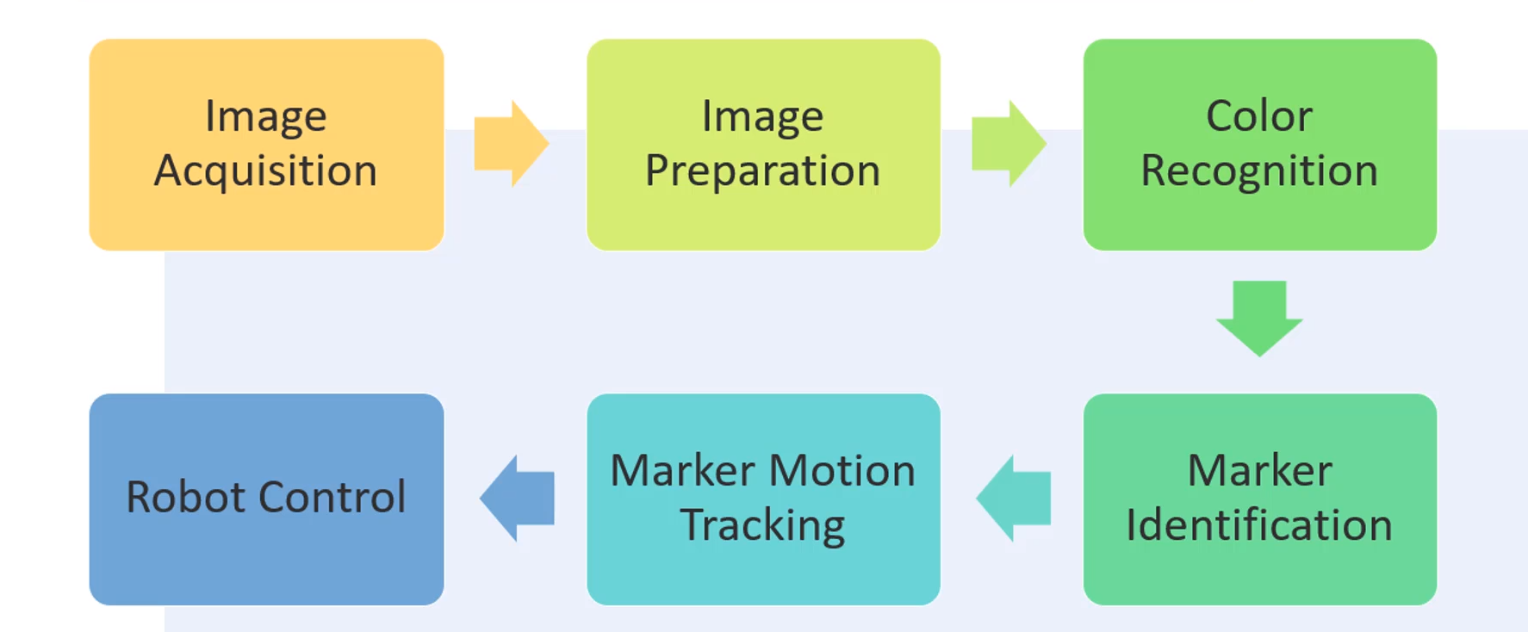
Pipeline for sixth Sense Robot

Slide 8
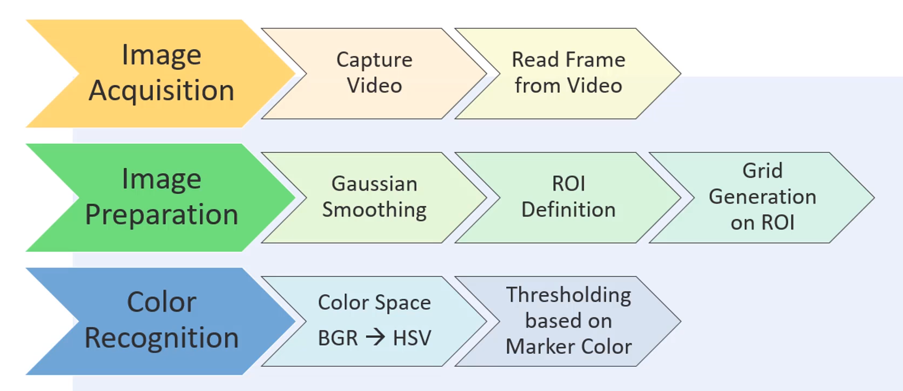

Slide 9
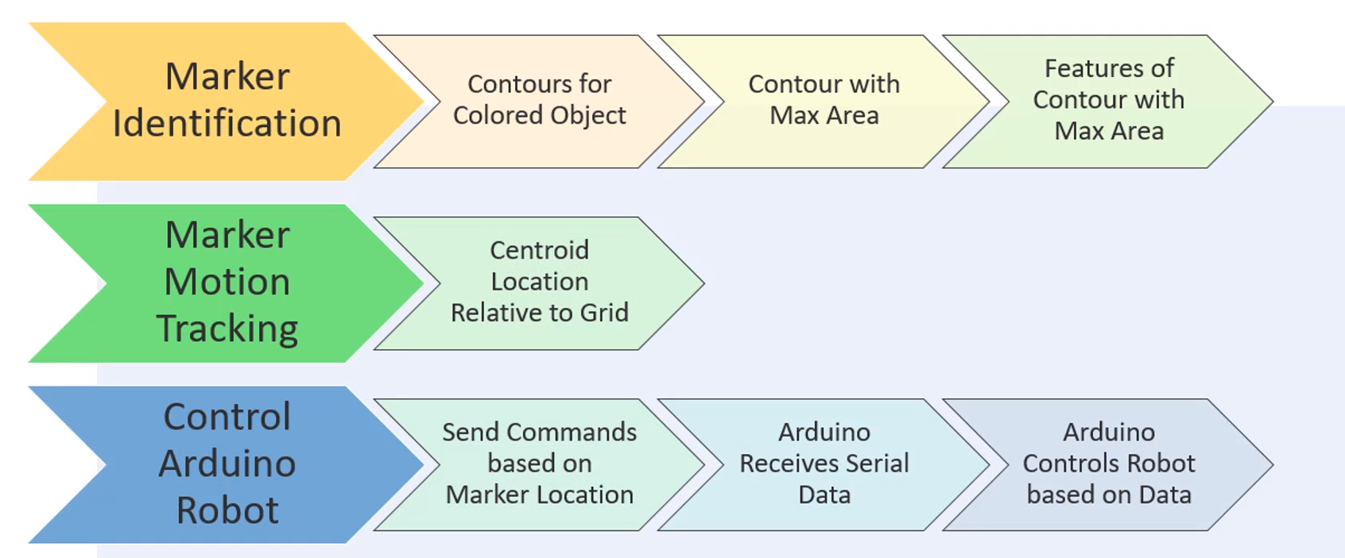

Slide 10
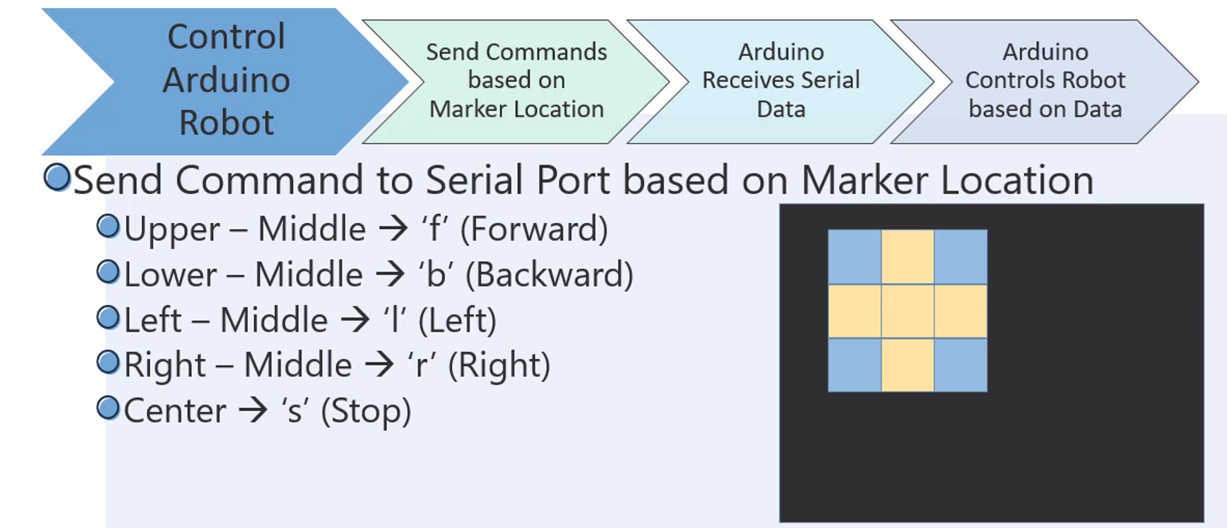

Slide 11
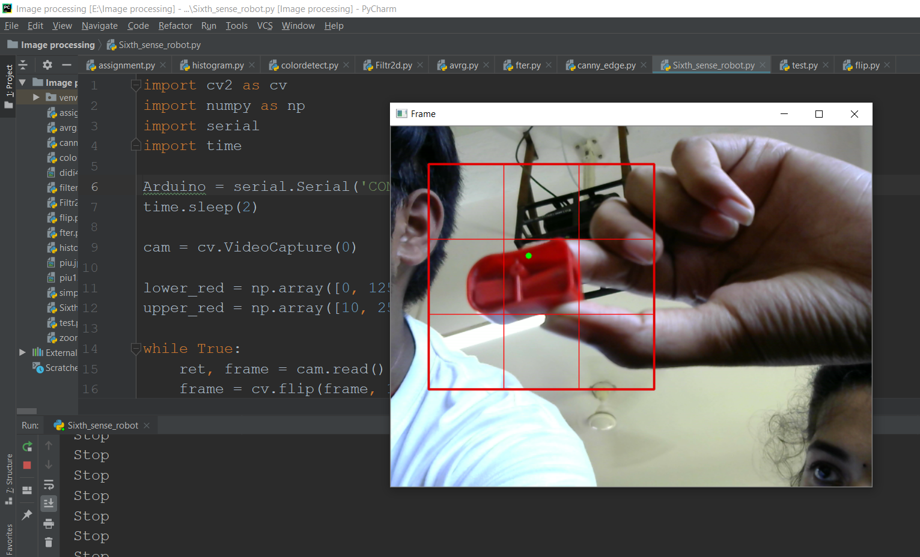

Slide 12
Pipeline of ultrasonic sensor
Take Input from ultrasonic sensor
Arduino receives the input signal
Motor
Output signals receives by the motor driver

Slide 13
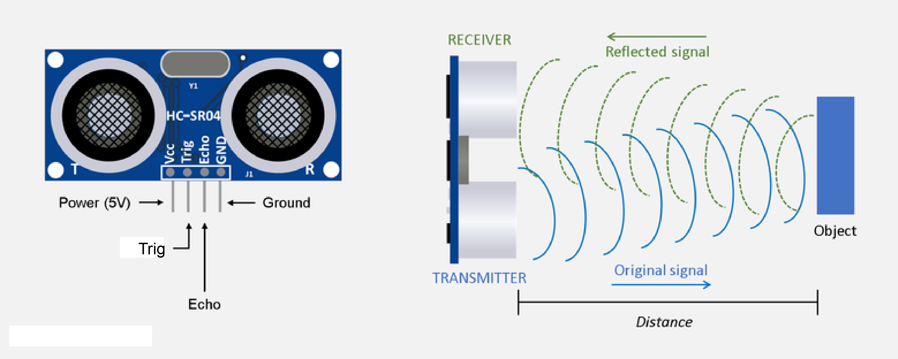

Slide 14
Pipeline of Voice Control
Bluetooth module receives these packets
Android App send Voice data Packet
BO Motor
Arduino sends signals to motor driver as per the value of data packets

Slide 15
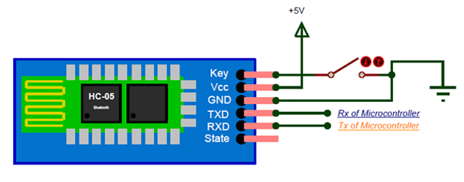
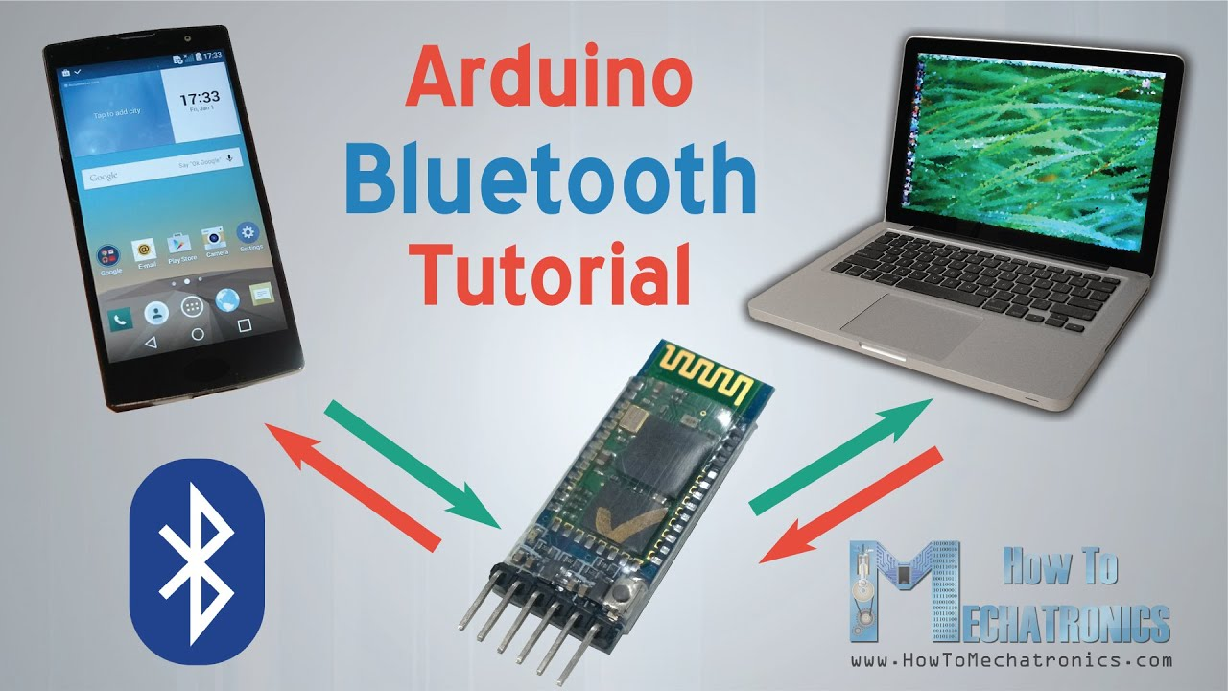
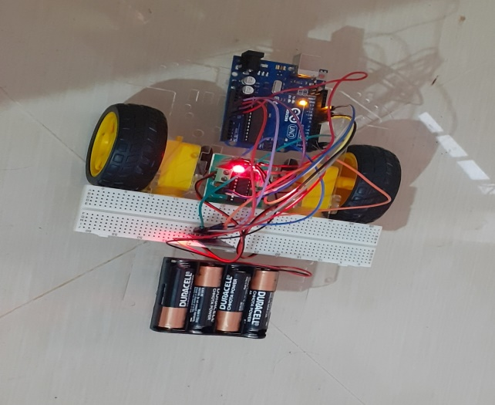

Slide 16
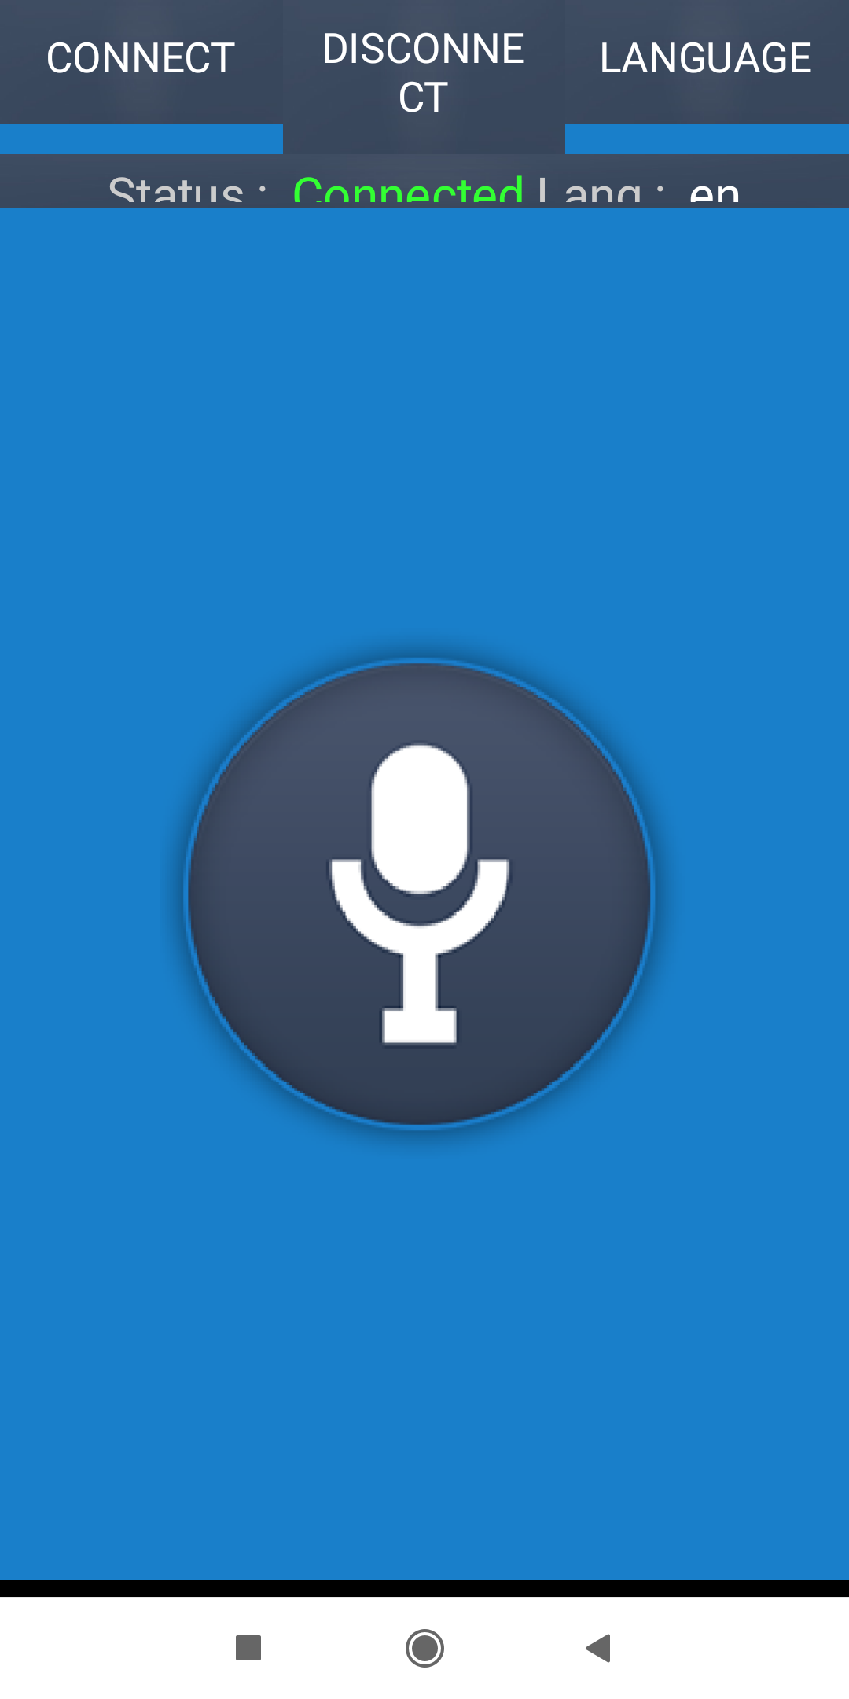


Slide 17
Conclusion & Future work
By using Arduino uno , Motor driver , ultrasonic sensor and Bluetooth module the self driving car was made functional to run. In future we will implement ROS and Computer vision with deep learning to make it fully functional.

Slide 18


